Slide 1
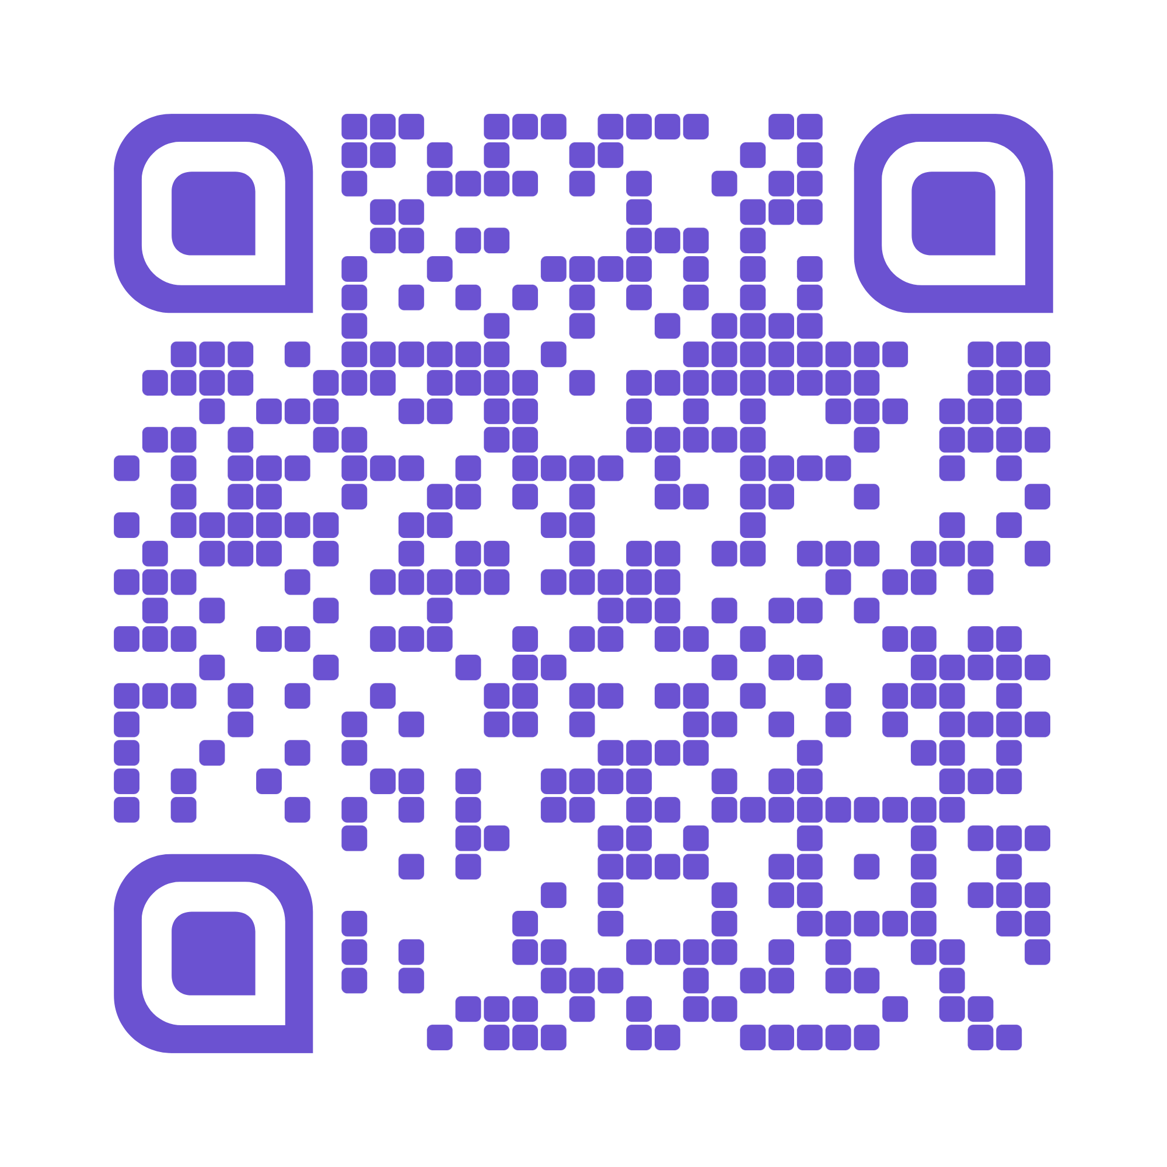
Quizzy
AI-powered quiz generation and study practice

Slide 2
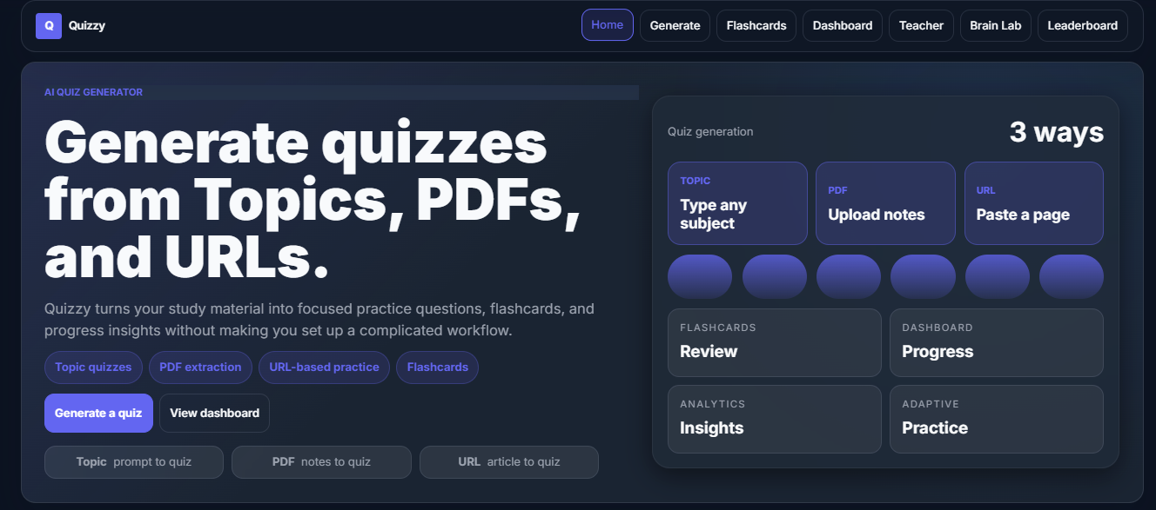
Home
Students start from a clean dashboard for quiz creation and study tools

Slide 3
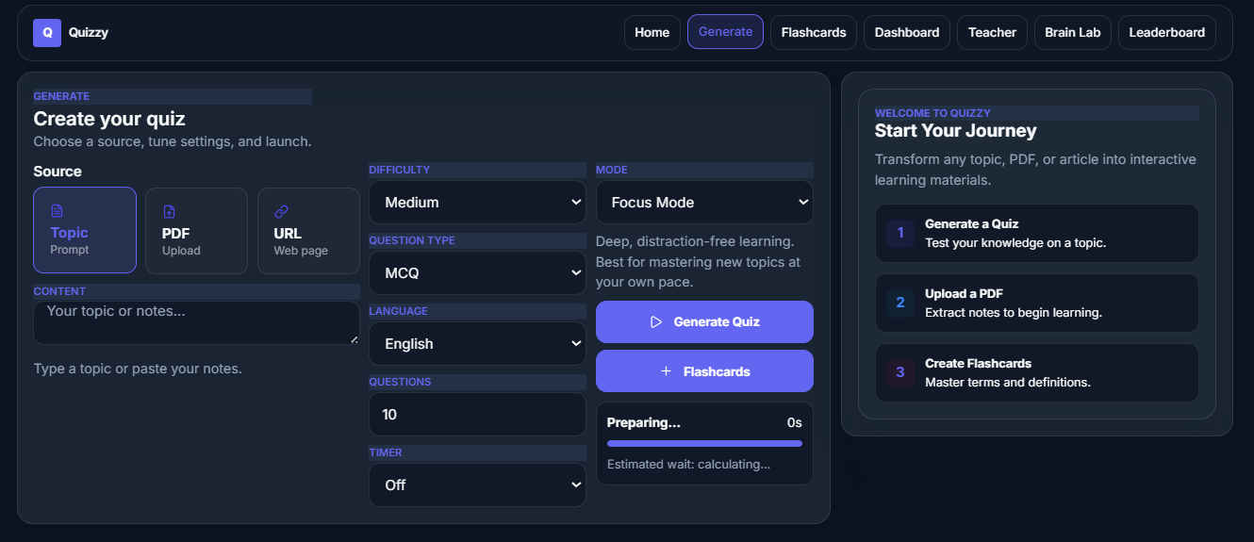
Generate Quizzes
Users enter or upload learning content and generate questions instantly

Slide 4
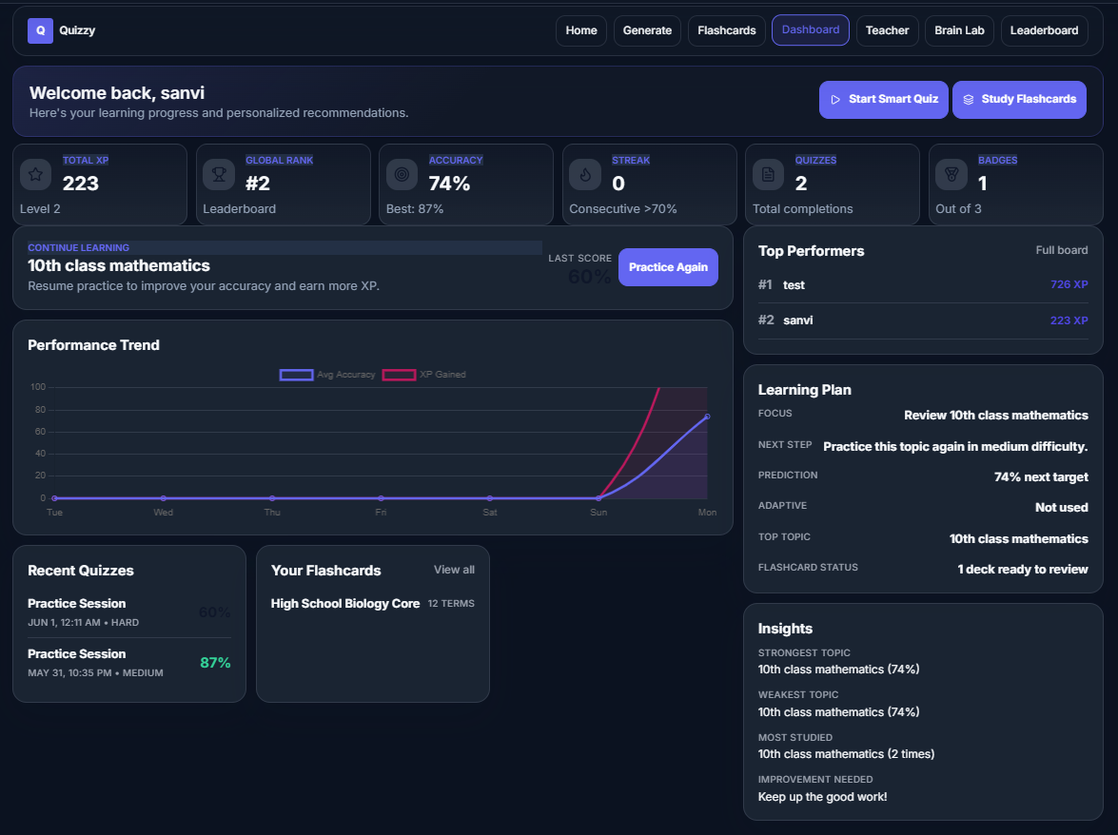
Student Dashboard
Quiz history, progress, stats, and learning activity are organized in one place

Slide 5
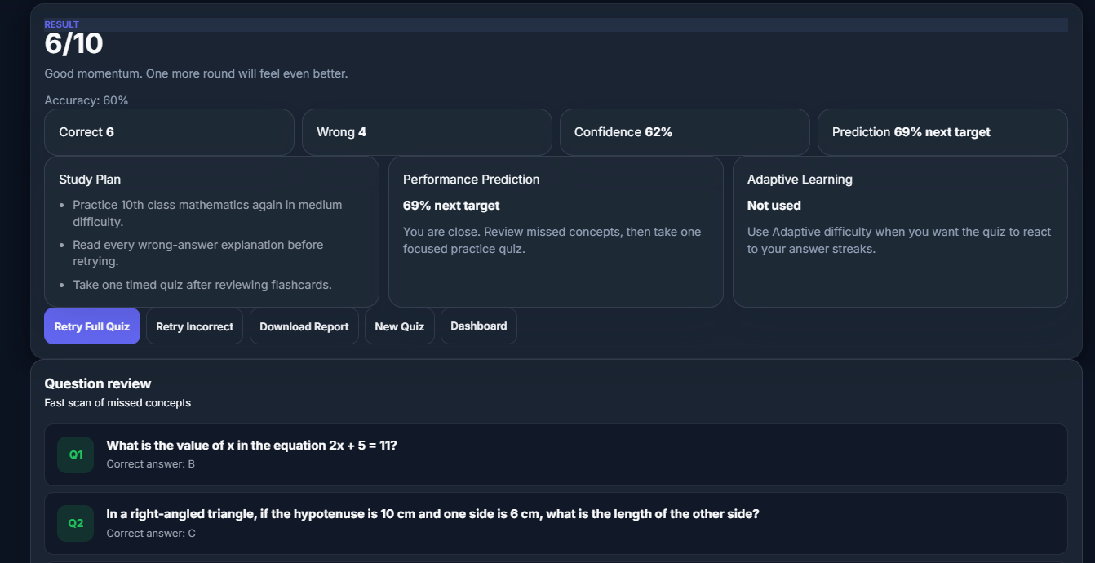
Results
The app shows scores and feedback after each quiz attempt

Slide 6
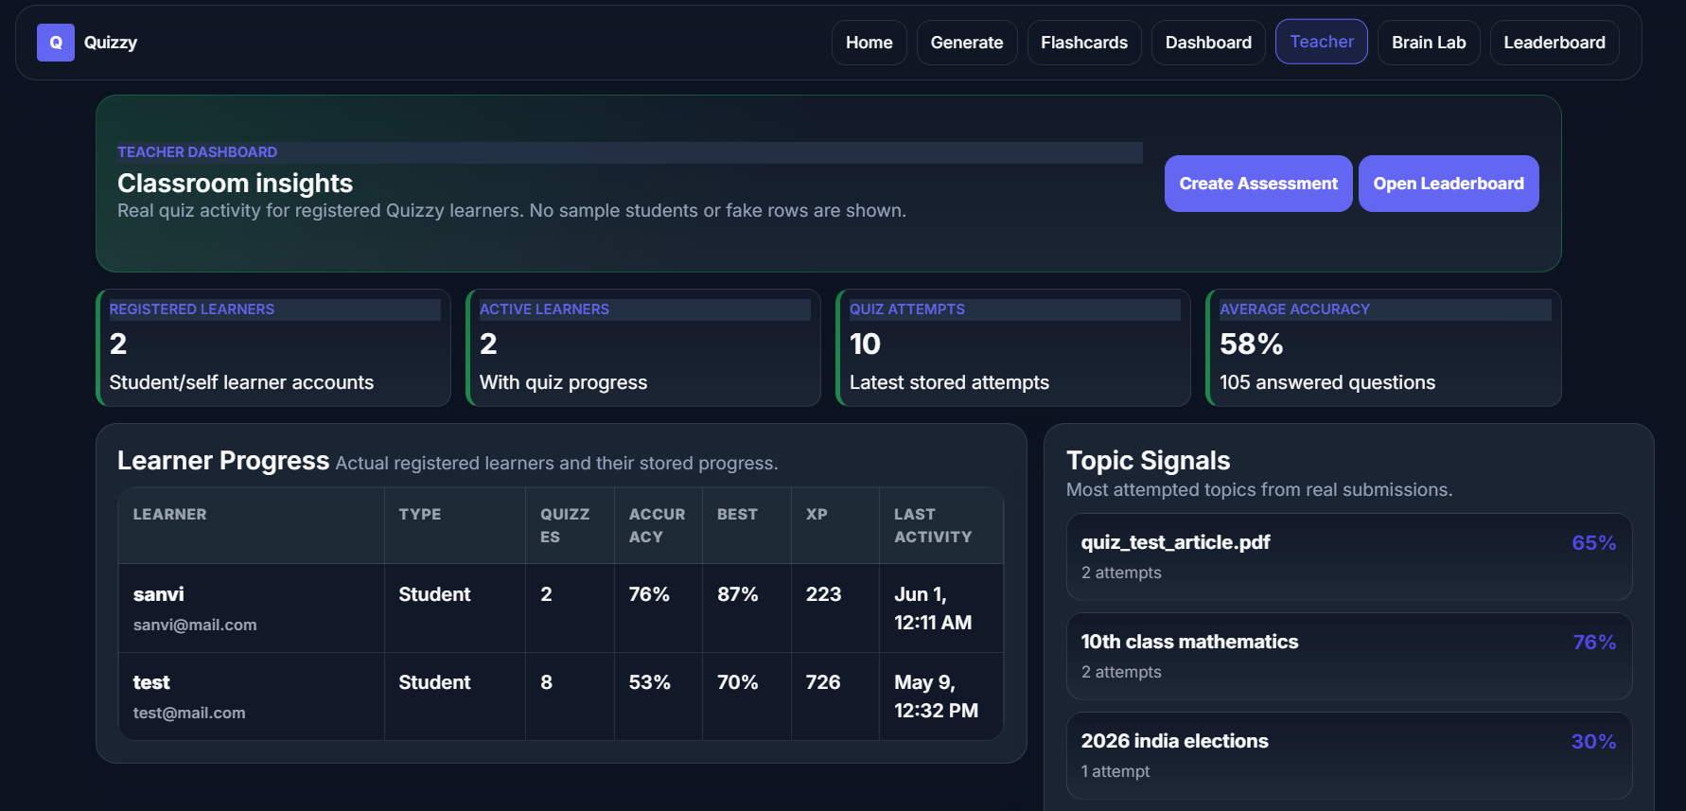
Teacher Review
Teachers can review questions, monitor activity, and support learners

Slide 7
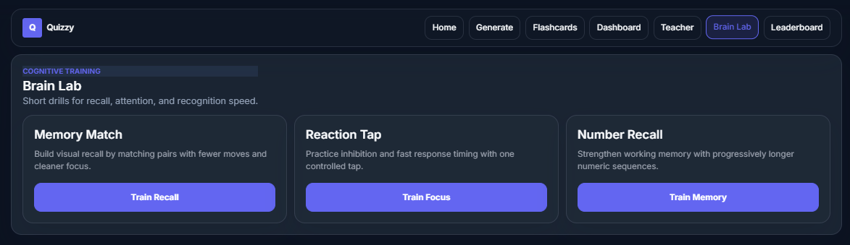
Complete Study Toolkit
Quizzy combines quiz generation, flashcards, practice games, and progress tracking

